Slide 1
PRESENTATION ON
“HOTEL MANAGEMENT SYSTEM APP”
PRESENTED BY:
ANURAG TAMRAKAR
RAJAT ACHARYA
SAUGAT SHAH
SANDHYA BARAL
SUSMA THAPA
SUPERVISOR:
UJJWOL SHAKYA

Slide 2
INTRODUCTION
Hotel Management System is an online application developed for effective handling and overall management of hotel works
Allow the manager to manage the hotel
Easy accessible to user

Slide 3
OBJECTIVES
To allow user to make advance booking
To provide effective room services
To save time and cost of users
To provide the facilities anytime from anywhere
To save organization’s resources and expenses

Slide 4
PROBLEM STATEMENTS
Manual working
Time wasting process
More chances of errors

Slide 5
BENEFITS
Automated working
Time saving
Less chance of errors
The app is portable i.e. can be used from anywhere
Manage guest reservations
Integration complexity and cost
Prevent double booking
Real time reports
Pay-as-you-go service and quick installation

Slide 6
FEATURES
Room booking
Food ordering
Notification/Email Confirmation
User can edit/delete/modify content
Admin can control user accounts and modify
Online payment

Slide 7
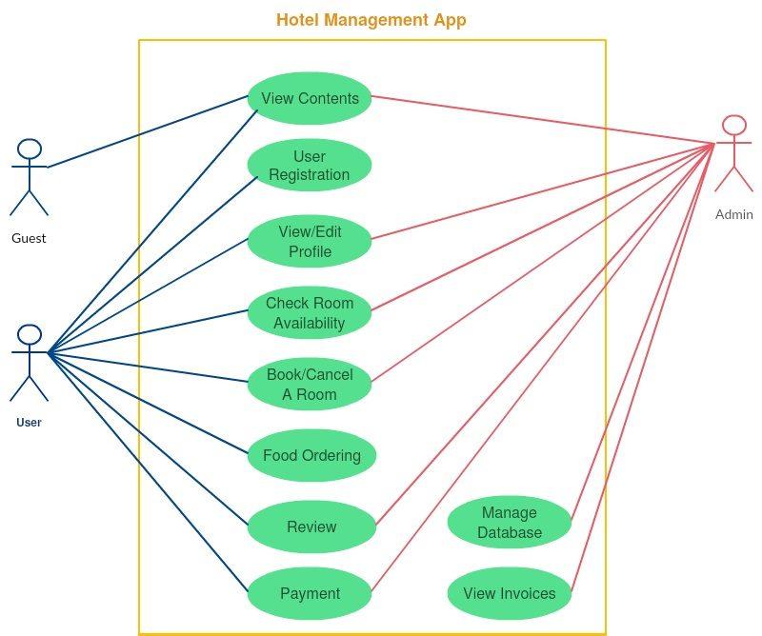
USE-CASE DIAGRAM

Slide 8
HARDWARE & SOFTWARE REQUIREMENTS
Hardware Requirement (for Developers):
Optimum 8 GB RAM 2 GB of available disk space minimum, Microsoft Windows10(64-bit)
Software Requirement:
Android Studio, Firebase online database, Photoshop
Android requirement (for User):
Android Device with 1GB RAM, 5 MB Storage Space , Minimum OS 6.0

Slide 9
METHODOLOGY
Requirement Analysis
Design
Coding
Implementation
Testing
Maintenance

Slide 10
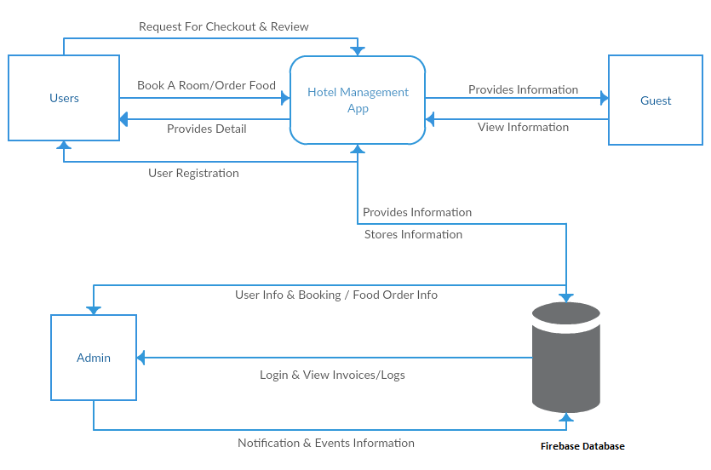
CONTEXT FLOW DIAGRAM

Slide 11
EXPECTED OUTCOMES
Customer can make advance booking using this system
User friendly and attractive interface for user
Hotel Managers can add/edit/delete/update information about their hotel and users
Customer can view information about extra hotel facilities
Cancelation of booked hotel room can be done with minimum amount of charges
Online Payment System
Food Ordering
Notification/email on room booking and food ordering

Slide 12
THANK YOU

